Slide 1
Customer Segmentation of a E-Commerce website
A NLP and Machine Learning project

Slide 2
Ideas to be Executed
Basic
Handling Null Values
Natural Language Processing
Word Tokenisation
Punctuation Removal
Stop Words Removal
Lemmatisation and POS tag
Vectorization
Machine Learning
K-Means clustering

Slide 3
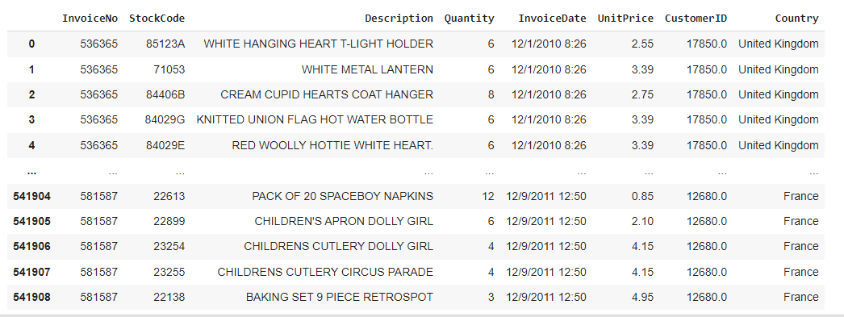
Dataset

Slide 4
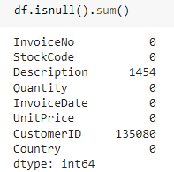
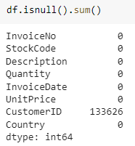
Basic
Null value Handling:
There were 1454 null values in the “Description” column and 135080 null values in “CustomerID” column. Since we could not arrive at a good filling method we had to drop the values. We had dropped only null values from Description column first, since we are working with Description only as of now.
Before Dropping: After Dropping:

Slide 5
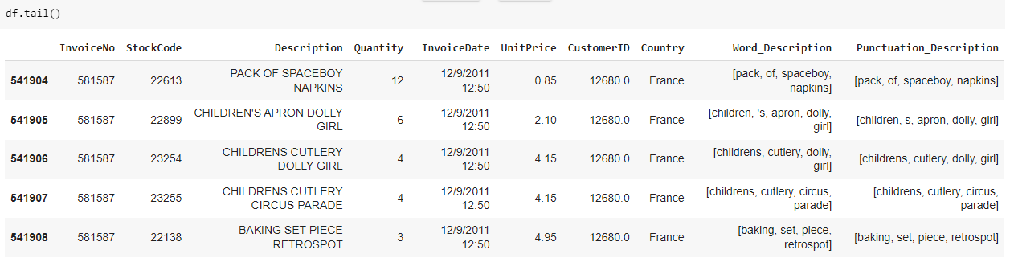
Word Tokenization and Punctuation removal
We removed the punctuations and did word tokenization for the Description column
df['Word_Description']=df.loc[:,"Description"].apply(lambda x: nltk.word_tokenize(str(x).lower()))
df['Punctuation_Description']=df.loc[:,"Word_Description"].apply(lambda x: tokenizer.tokenize(str(x))

Slide 6
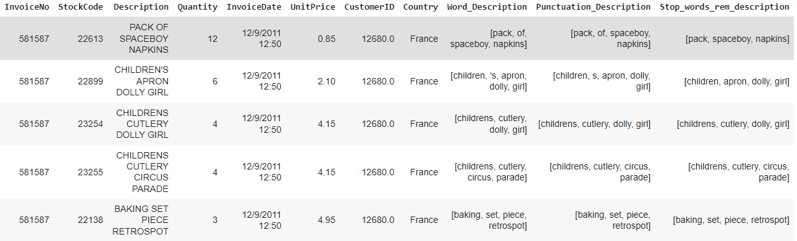
Stop Words Removal
Words like (is,for,at,a,an…) comes under stop words and do not add much meaning to the product description and so they are removed from the tokenized words.
from nltk.corpus import stopwords
stop_words = stopwords.words("english")
df['Stop_words_rem_description'] = df['Punctuation_Description'].apply(lambda x: [word for word in x if word not in (stop_words)])

Slide 7
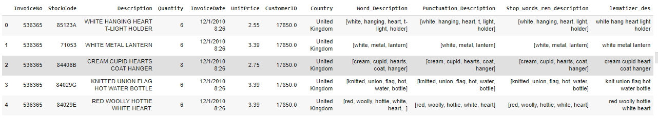
Lemmatization and POS Tag
Using nltk.pos_tag the words were tagged with their corresponding POS tag and they were used to lemmatize the words.

Slide 8
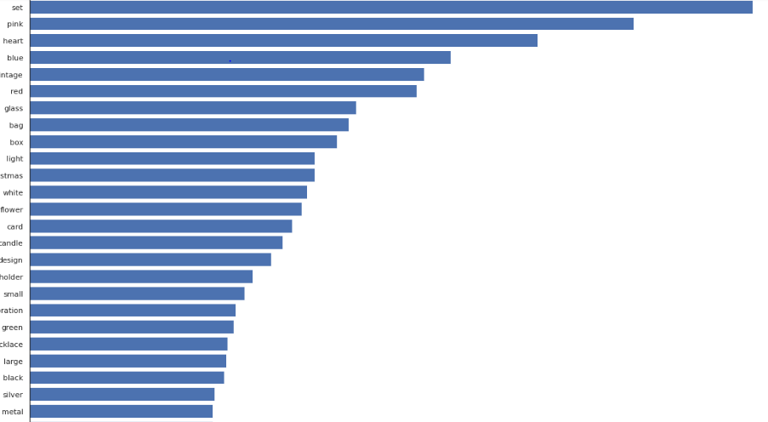
Count Plot of Words

Slide 9
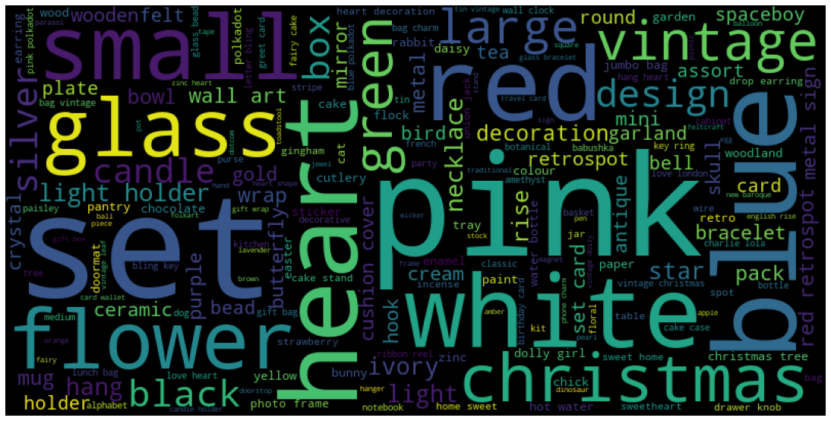
Word Cloud

Slide 10
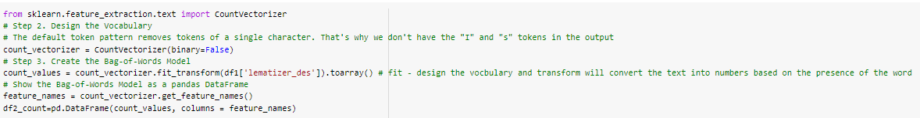
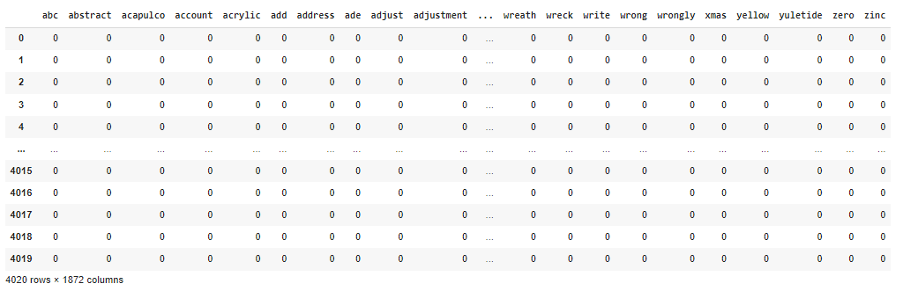
Count Vectorization-Frequency Approach
We used a simple frequency count method to vectorize our words.

Slide 11
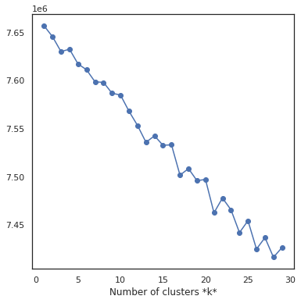
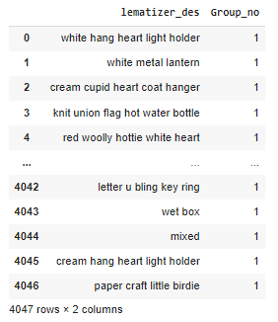
Machine Learning-Clustering-Kmeans Clustering
From the Elbow plot, We assumed the K value to be 20 and executed the Kmeans clustering. Created a dataframe which tells each description belongs to which cluster.

Slide 12
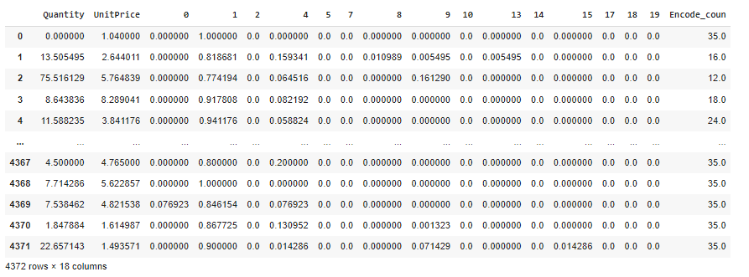
Machine Learning-Contd.
We did one hot encoding on cluster numbers we arrived at and label encoding on Country of the customers. We further grouped the data based on customers taking mean of all values. There were 4372 unique Customer IDs.

Slide 13
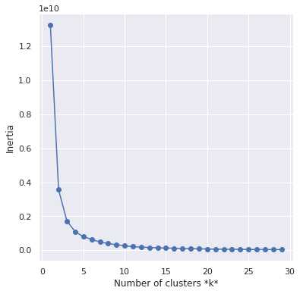
KMeans-Elbow plot
By plotting the inertias, we determined the K value to be 10.

Slide 14
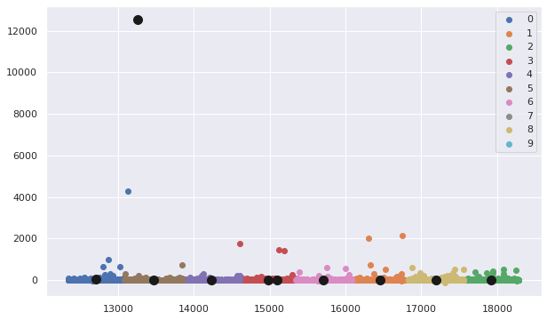
Clustering of Customers

Slide 15


